Slide 1
VPD Surveillance
Initiation Update
District Workshop

Slide 2

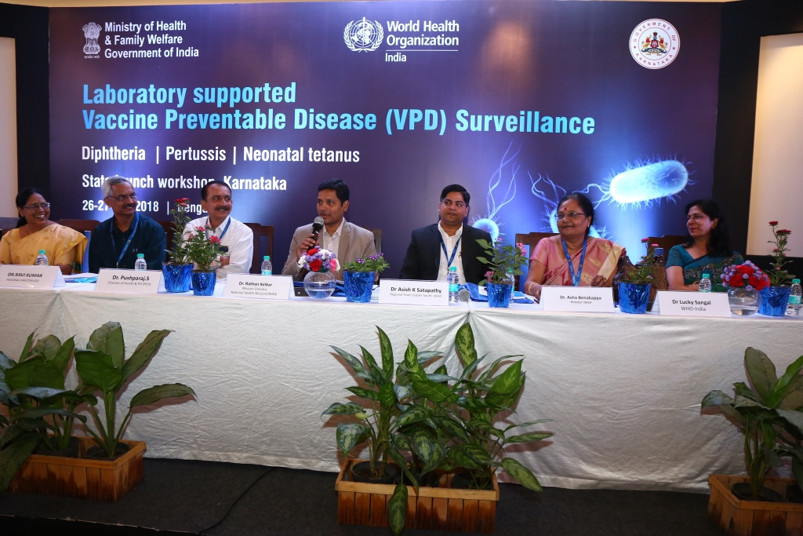
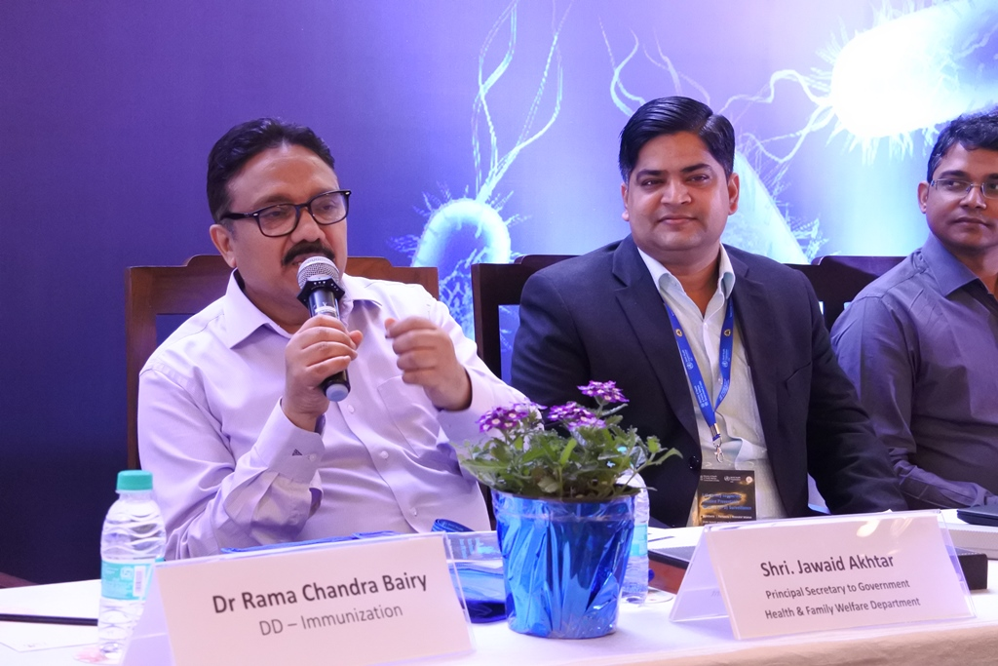
Lab supported VPD Surveillance - Karnataka
Karnataka – 8th state in the country to start WHO lab supported VPD surveillance
Case investigation, sample collection, shipment - transitioned to Government – Unique model of RCH & IDSP coordination.
State VPD launch workshop in Karnataka conducted in July 2018 ;district workshops completed > 1500 MOs trained so far
BMC Lab strengthened ; officially reporting started from 12 November
Advocacy, oversight, lab co-ordination, data analysis & feedback - NPSP

Slide 3
SOPs
Role and Responsibility of RCHO
Case investigation: All cases notified to the district should be investigated
Give unique EPID Number and maintain the register to avoid duplicate numbers
Coordinate with DSO for sample collection and tracking shipment
Vaccination status assessment, post OB vaccination and RI strengthening
Reporting Network expansion, orientation and ACS visits
Feedback Sharing with Reporting sites and parents
Review Immunization Field Volunteer (IFV) weekly work plan to include VDP surveillance and appraise monthly performance in consultation with SMO-WHO to strengthen VPD surveillance

Slide 4
SOPs
Role and Responsibility of DSO
Sample collection and Shipment to laboratory for every case reported
Public Health interventions to be conducted Under guidance of District / Taluka ERT, facilitated by District Epidemiologist
Active case search in the community
Contact tracing and Prophylactic antibiotic therapy
Out Break investigation - Sample collection, daily reporting and Final report writing

Slide 5
SOPs
Role of District Surveillance Unit:
  procedures along with VPD Lab Request Form to WHO accredited VPD laboratory at Bangalore Medical College address as below
Dr. Ambica. R
Professor and HOD
Mycology section, Microbiology Laboratory
3rd Floor Infosys Central Laboratory, Victoria Hospital Campus, Fort
Bengaluru- 02, Ph no.9448688998

Slide 6
Public health interventions
Age | Immunization | Prophylaxis
 |  | Antibiotic | Dose | Route | Duration
< 7 years old | DPT | Penicillin G benzathine | 600 000 units | IM | Single dose
 |  | or
 |  | Erythromycin (not recommended for age <1month) | 40 mg/kg in 4 divided doses | Per oral | 7-10 days
> 7 years old | DT/Td/Tdap as per availability | Penicillin G benzathine | 1.2 million units | IM | Single dose
 |  | or
 |  | Erythromycin | 1g/day in 4 divided doses | Per oral | 7-10 days

Slide 7
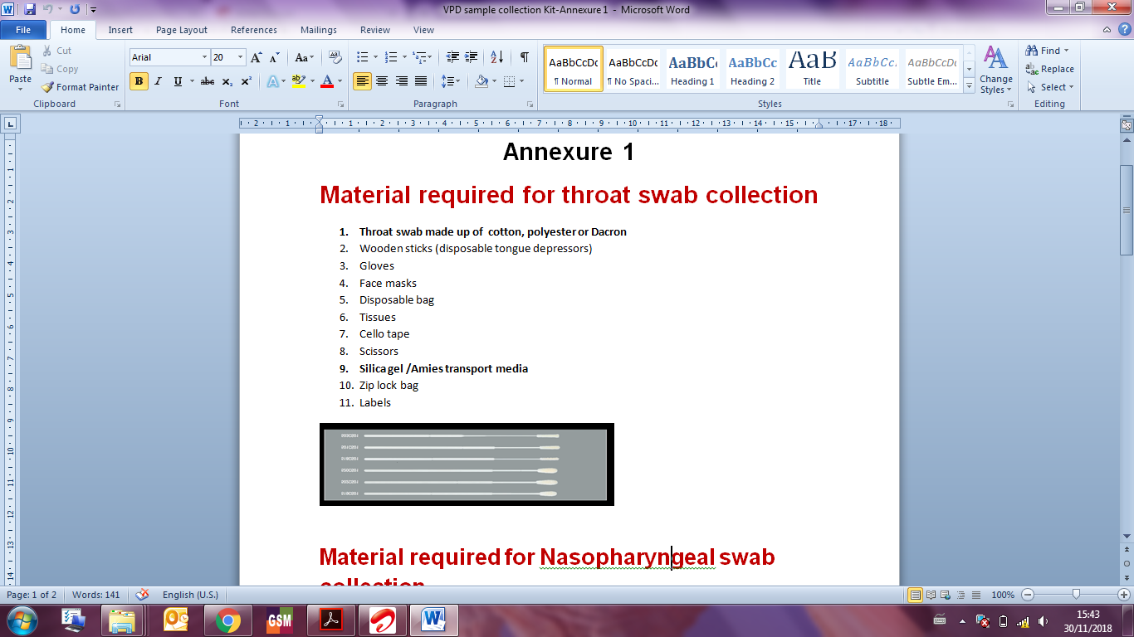

Diphtheria

Slide 8
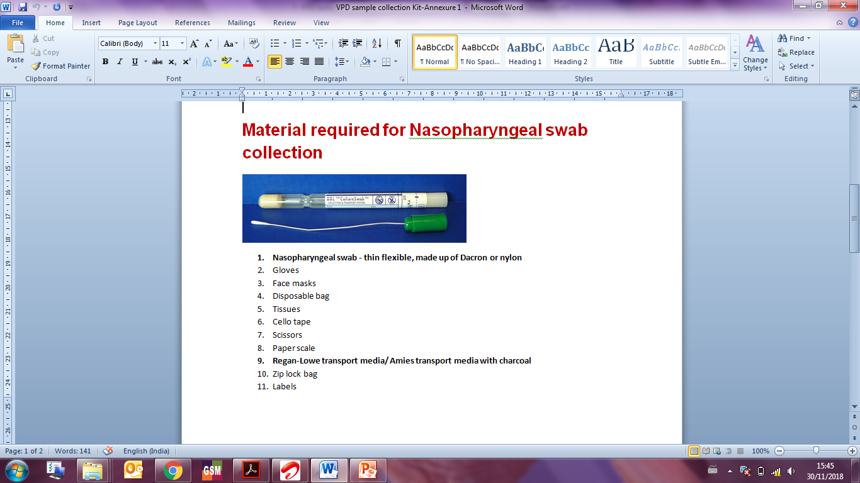
Diphtheria

Slide 9

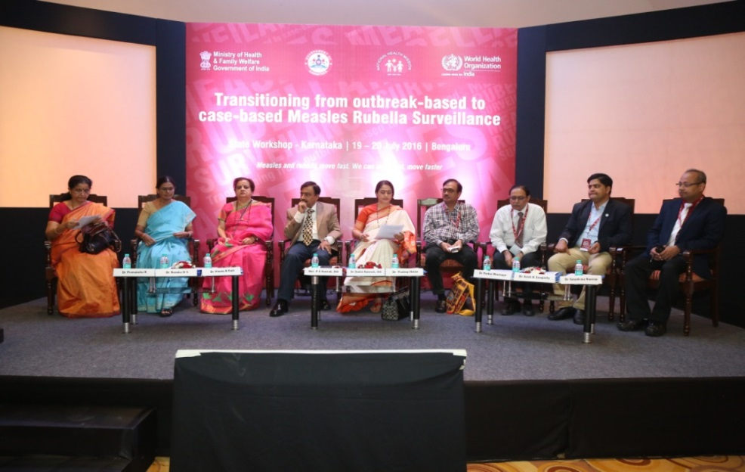
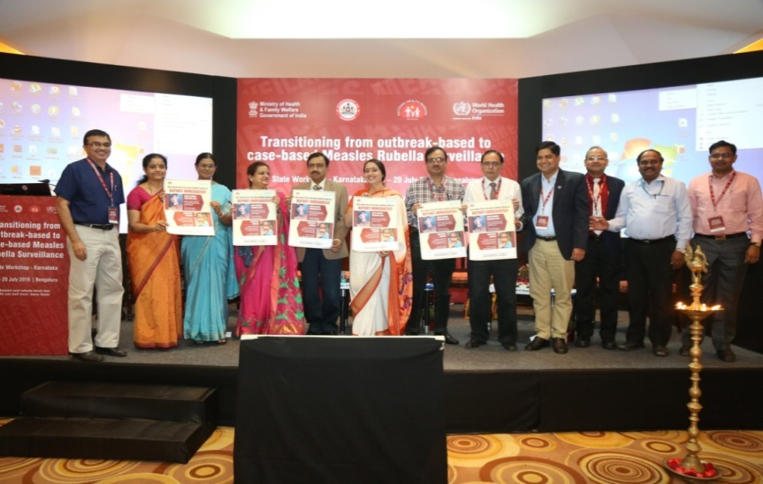
Transition from Outbreak-based to Case-based MR Surveillance
Launched
Case Based Surveillance Launch workshop -2016
Case-based surveillance launched: 19 states
Planned: 17 states
Karnataka – 1st state in country to start Fever Rash Surveillance
from 19 Nov 2018

Slide 10
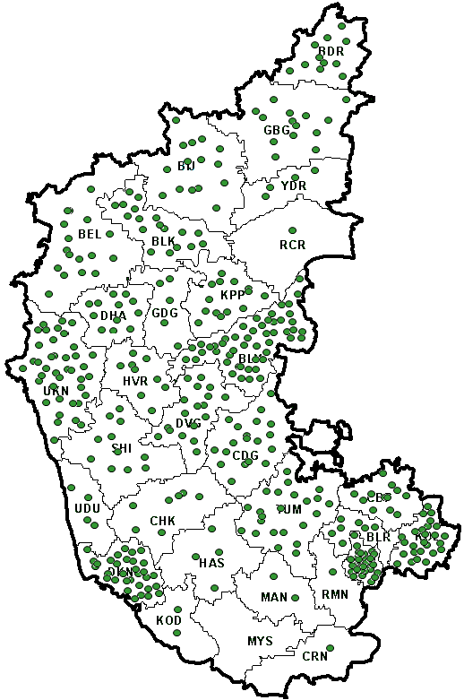
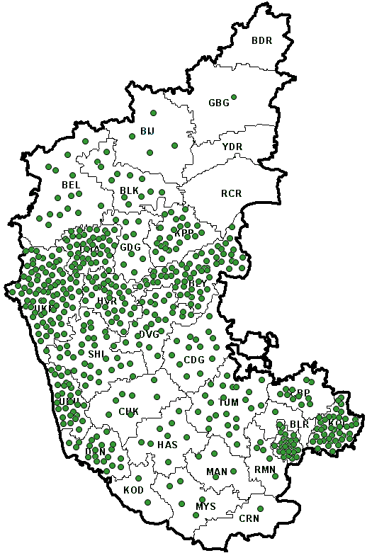
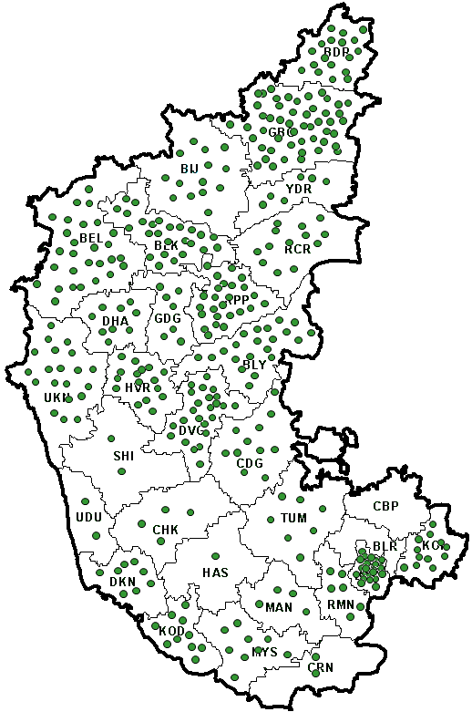
Spot map of Sporadic MR cases reported; Karnataka
2016
2017
2018*
Sporadic cases - 419
Sporadic cases - 548
Sporadic cases - 398
*Data as of Week No.47, ending of 24/11/2018

Slide 11
MR Surveillance Performance surveillance indicators – Karnataka
Indicators | 2016 | 2017 | 2018*
Number of Sporadic cases reported | 419 | 548 | 398
% suspected cases with adequate investigation with 48 hours | 71% | 82% | 79%
% cases with serum sample collected | 88% | 85% | 79%
% serum sample received in laboratory within 5 days of sample collection | 80% | 75% | 70%
% serum sample with Measles confirmed | 40% | 19% | 10%
% serum sample with Rubella confirmed | 12% | 24% | 4%
Discarded non-measles/non-rubella rate per 100,000 population
*Data as of Week No.47, ending of 24/11/2018

Slide 12
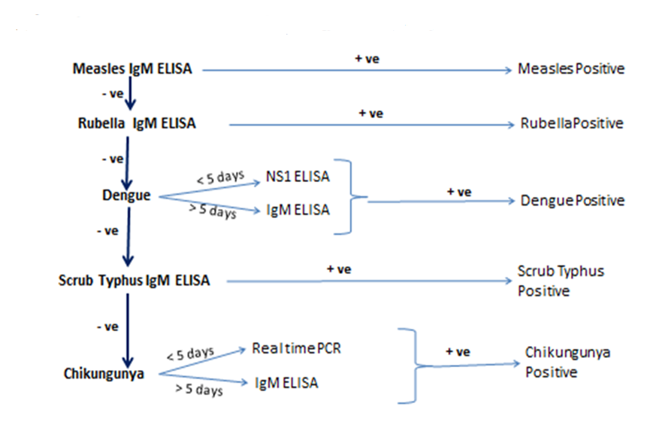
Lab algorithm for testing serum specimen

Slide 13
Measles Surveillance ( Case Based & Outbreak)
Measles Case
Information
Reporting Sites – Medical College, GH , Pvt Paediatrician ,PHC , others etc
Investigate each sporadic case that is reported using standard MR-CIF
RU - Weekly Report along with AFP
Cold Chain
1.NIV Bangalore
2. Manipal Centre for Virus Research, Manipal
Sample Collection ( 0-7 days – Throat swab )
( < 28 days - Serum )
Desk Review of Measles data every Tuesday at district level
Identify outbreaks with 5 cases in a block or 1 death in 4 - weeks period
Cold Chain
Outbreak ID Vit A
Sample Collection from 5 cases
0-7 days – Throat swab
< 28 days - Serum
Conduct detailed outbreak Investigation as per existing protocols

Slide 14
Thank You

